Slide 1
NTSC / PAL Video Encoder
R&D 2
2 / Feb / 2007

Slide 2
차 례
  NTSC / PAL ??
    NTSC (National Television System Committee)
    PAL (Phase Alternation Line)
  NTSC/PAL (Entertech)
  NTSC / PAL Encoder
    Diagram
    Y generation
    C generation
    Output signal

Slide 3
NTSC / PAL
  NTSC (National Television System Committee)
    525 Line @ 60Hz
    composite NTSC = Y + U sin(ωt) + V cos (ωt) + timing
  PAL (Phase Alternation Line)
    625 Line @ 50Hz
    composite PAL =Y + U sin(ωt) ± V cos(ωt) + timing

Slide 4
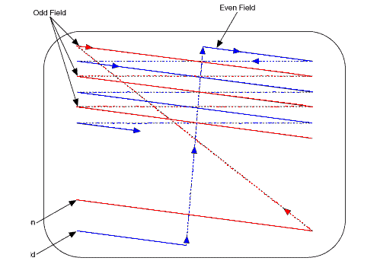
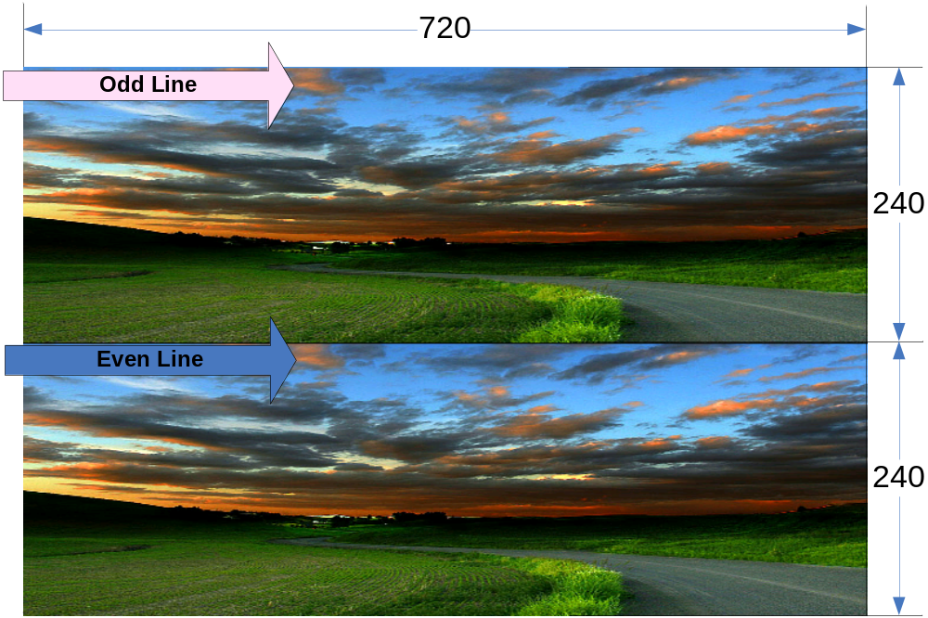
NTSC / PAL Interlace
  Odd line :: Red
  Even line :: Blue
odd
even

Slide 5
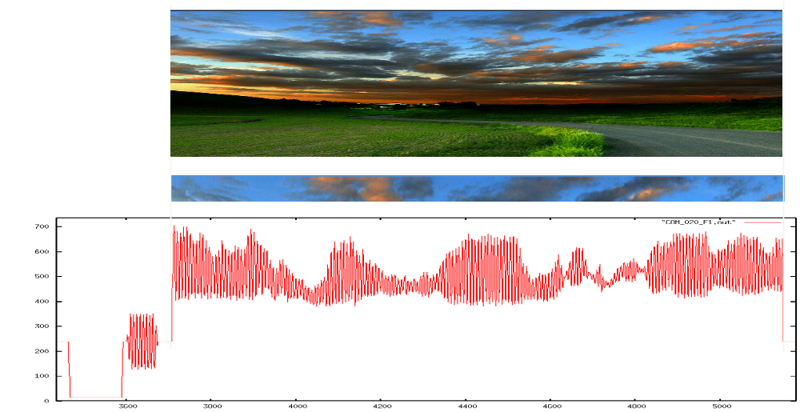
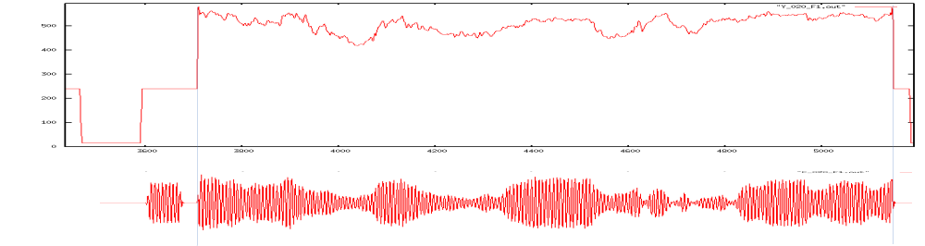
NTSC / PAL Signal
Luminace
Chrominace

Slide 6
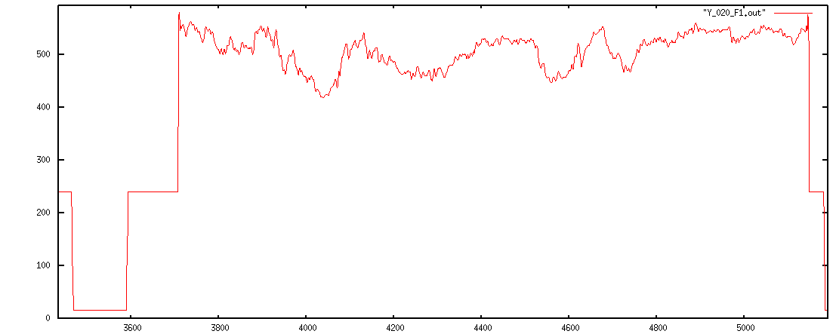
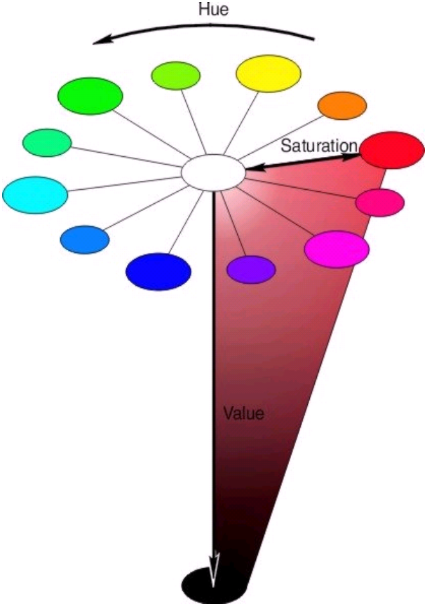
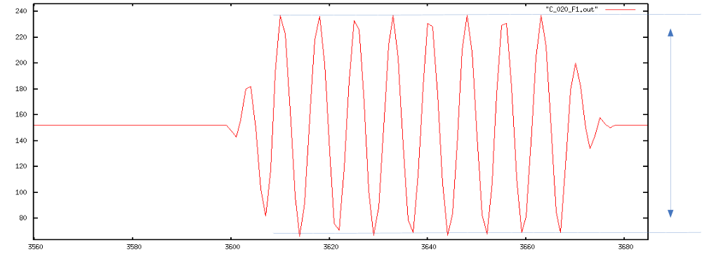
Hue / Saturation / Value
value
Luminace
Saturation
Chrominace
Hue → Phase

Slide 7
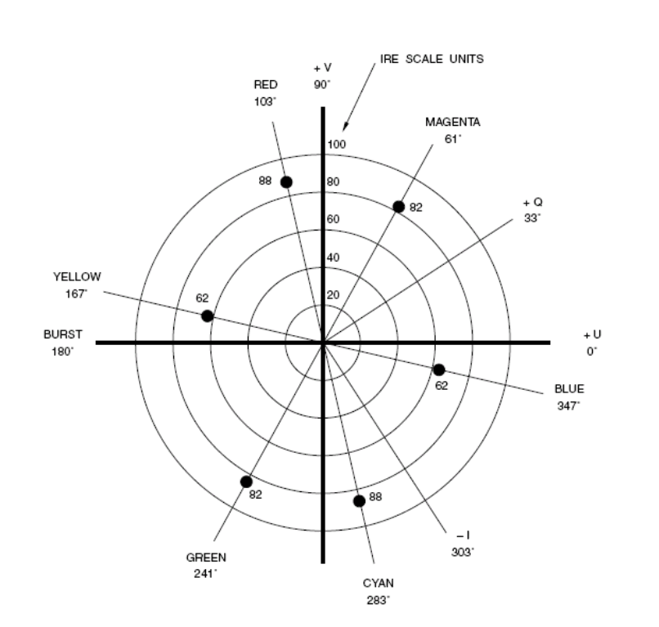
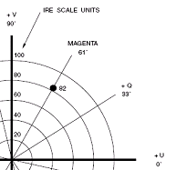
NTSC Saturation and Hue
composite NTSC = Y + U sin(ωt) + V cos (ωt) + timing

Slide 8
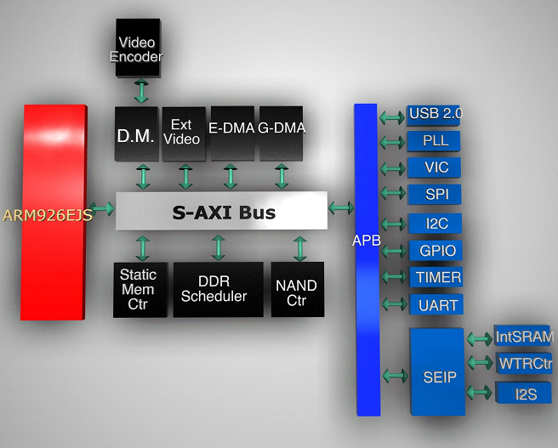
NTSC / PAL Encoder (Entertech)

Slide 9
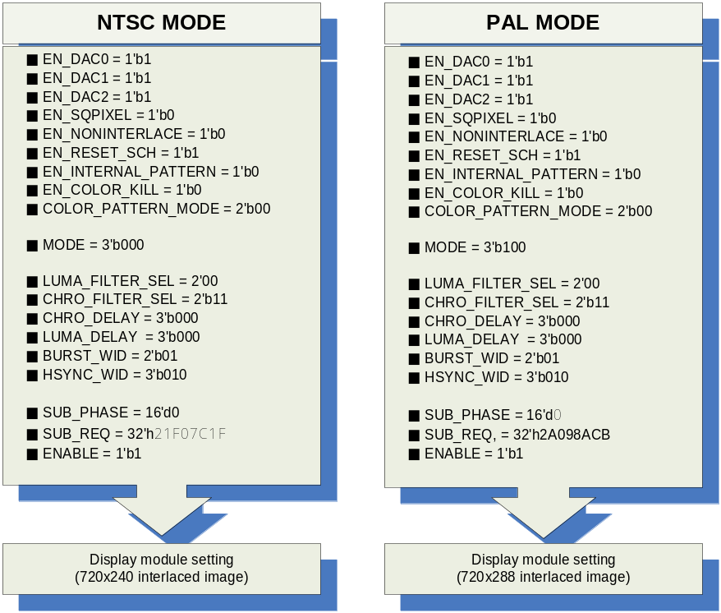
NTSC / PAL Encoder (Entertech)
  MODE :: NTSC M/J/4.43 , PAL(B, D, G, H and I) /Nc/N
  EN_NONINTERLACE
  EN_SQPIXEL
  EN_COLOR_KILL
  EN_RESET_SCH
  CHRO_DELAY
  LUMA_DELAY
  BURST_WIDTH
  HSYNC_WIDTH
  SUB_PHASE
  SUB_REQ

Slide 10
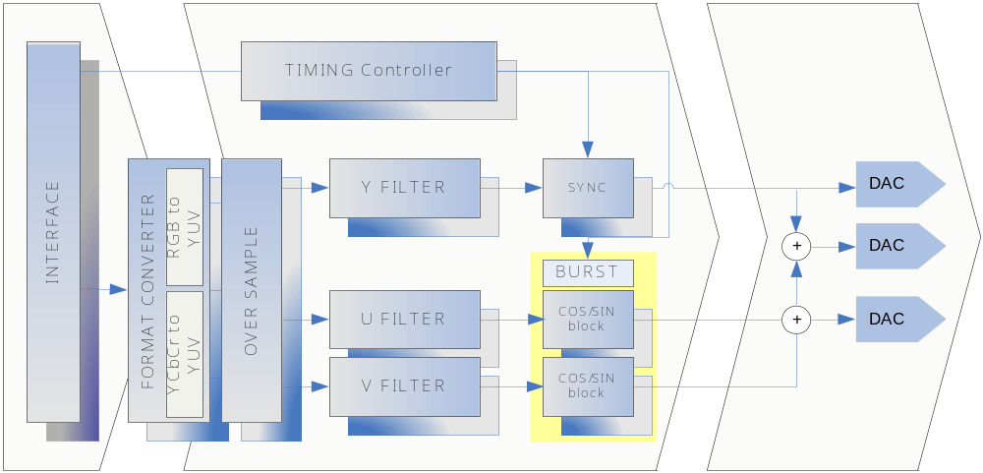
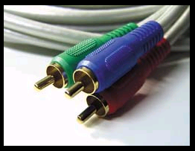
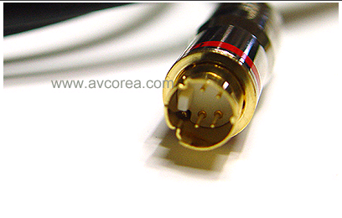
NTSC / PAL Video encoder Block diagram

Slide 11
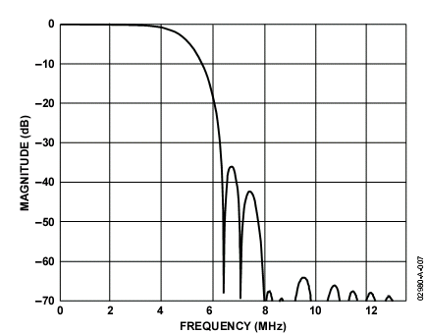
Y Signal generation
RGB to Y
Converter
Filter
Timing
Y [9:0]
R [7:0]
G [7:0]
B [7:0]

Slide 12
C Signal generation
SIN
RGB to Y
Converter
U
Filter
U
X
R [7:0]
+
C
G [7:0]
V
Filter
V
X
B [7:0]
Burst
COS
COS
SIN

Slide 13
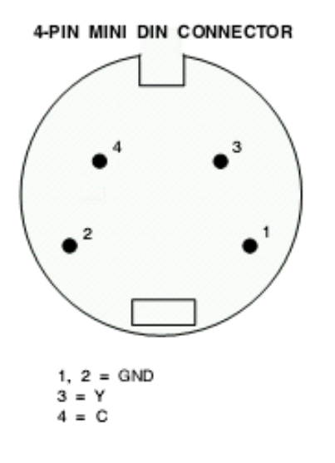
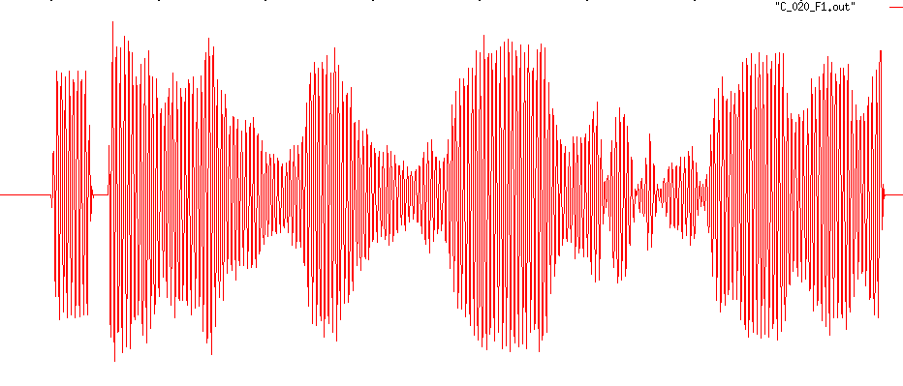
NTSC / PAL Composite Output

Slide 14
NTSC / PAL 설계 단계
설 계 방 향 검 토 / Spec 검 토
C modeling
FPGA TEST (C output dump)
Verilog Coding
DM + Video Encoder Test
FPGA TEST (Rtl Code)

Slide 15

Thank you

